Slide 1
Introduction to SSL/TLS & Their Attacks
Rian Saaty
Senior Cybersecurity Consultant

Slide 2
Who Am I?
Bachelor’s Degree in Computer Science from Duquesne University
Master’s Degree in Cybersecurity Engineering from Johns Hopkins University
Worked as a lecturer at King AbdulAziz University, FCIT
Worked as Cybersecurity Techniques Unit Manager at the IT Deanship at KAU
Currently a Penetration Testing & Vulnerability Assessment Consultant at one of the biggest cybersecurity consulting firms in the Kingdom
Hold a number of top-notch industry certificates such as OSEP, OSCE, OSCP, GPEN, CRTE, CRTO, GWAPT, GDAT, eCPTX, OSWP, etc.

Slide 3
Why Talk About SSL/TLS Now?
It doesn’t seem that people really understand what’s going on …
Does TLS make a website legit/secure 100%?
Is it about the lock?
Is it about the version? The ciphers?

Slide 4
It is WIDELY USED!
SSL/TLS is a widely used protocol, a vulnerability in it or in an application that implements it WILL result in millions of websites exposed including the big ones!
In 2014, when the HeartBleed vulnerability was discovered, a lot of major websites such as Github, Amazon AWS, Reddit, Wikipedia, Yahoo, etc. were vulnerable to it!
Some government entities temporarily shut down their servers!
More on HeartBleed later

Slide 5
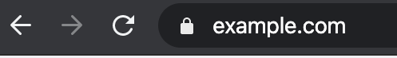
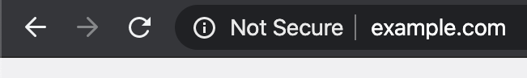
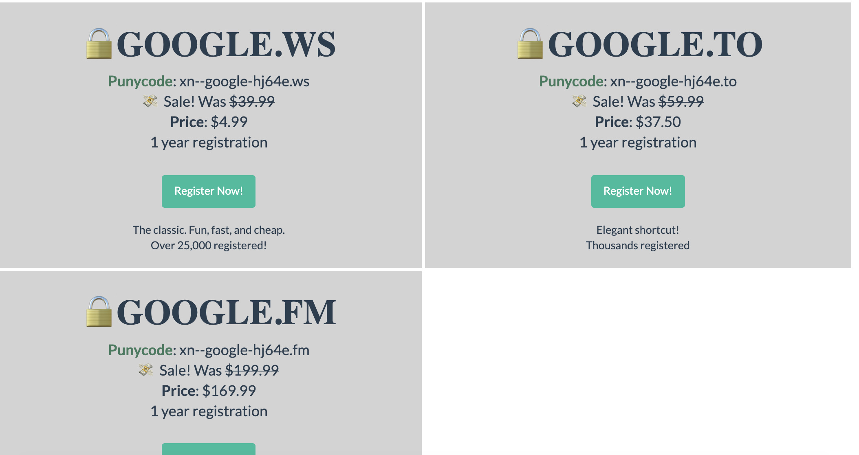
Appetizers

Slide 6
SSL/TLS Certificates
Certificate Authority (CA): a trusted organization that verifies websites’ SSL/TLS certificates.
Usually there are 2 types of certificates:
1- Self-Signed (You are the CA) – May be good enough. I.e. Google
2- Signed by a trusted CA - $$ (May be included with some CDNs I.e. Cloudflare)
If a website has a signed certificate that is valid, it doesn’t mean that the website is NOT malicious!
If a website has a self-signed certificate, it does NOT mean that it is malicious!

Slide 7
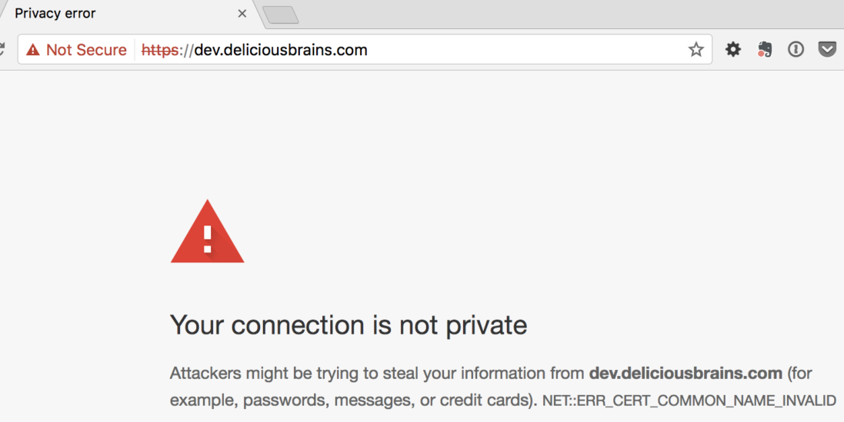
Self-Singed Certificate Example

Slide 8
Imagine a CA compromised
We trust CAs
If they were compromised, we will STILL trust them until we revoke the certificate!
We can sign as the CA and users will TRUST us!
This happened in 2011 with a CA called, DigiNotar, who got bankrupt in weeks after the incident.

Slide 9
SSL/TLS
Used to encrypt/secure reliable protocols such as?
Does not require pre-shared keys (Public Key)
The talk will NOT go deep into SSL/TLS rather it will be an intro to it & to some of the critical vulnerabilities in it.

Slide 10
Why Do We Use TLS/SSL?
Let’s consider that we don’t have it …

Slide 11


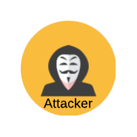
Threat Models
Passive Adversary

Slide 12
Threat Models
Active Adversary

Slide 13
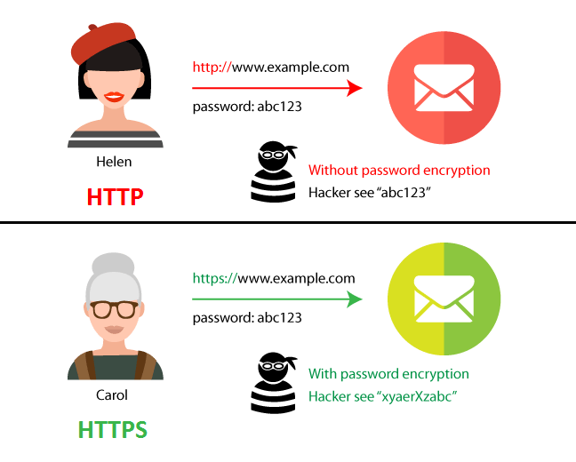
In Other Words …

Slide 14
SSL/TLS History
SSLv1 born at Netscape. Never released (insecure). (~1994)
SSLv2 released one year later (Had a lot of problems … i.e. export keys)
SSLv3 (1996) (less flaws but still a huge security risk)
TLS 1.0 (1998) (name was changed because of Microsoft)
TLS 1.1 (2006)
TLS 1.2 (2008)
TLS 1.3 (2018)

Slide 15
SSL/TLS
VERY flexible protocol (good and bad)
So many options!
Backwards compatibility (TLS1.0 >SSLv3 > SSLv2)

Slide 16


SSL/TLS: Negotiation
This is called server hello
This is called client hello
Negotiate Capabilities
I choose TLS 1.0
I choose cipher suite X
I speak SSLv3 & TLS 1.0
I support cipher suites X, Y

Slide 17
Cipher Suites
Consists of:
Key Agreement Protocol (I.e. RSA, DH, Elliptic Curve)
Symmetric Encryption Protocol (AES)
HASH Function
KA_SE_Hash

Slide 18
SSL/TLS: Certificate Exchange
Exchanging Certificate
Sends a certificate:
{PK, example.com, expiration date, signed by PK}

Slide 19
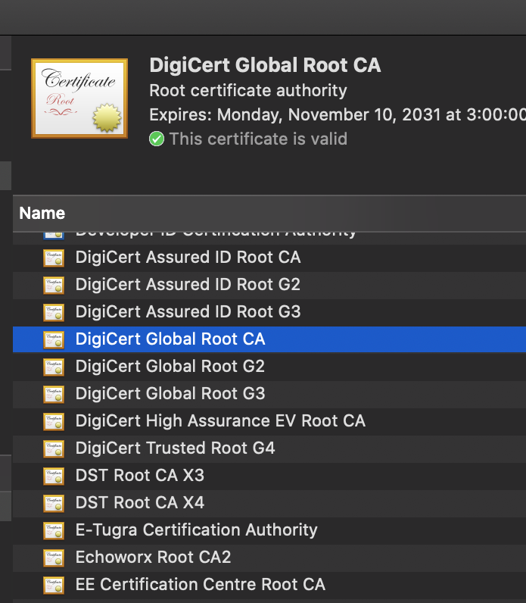
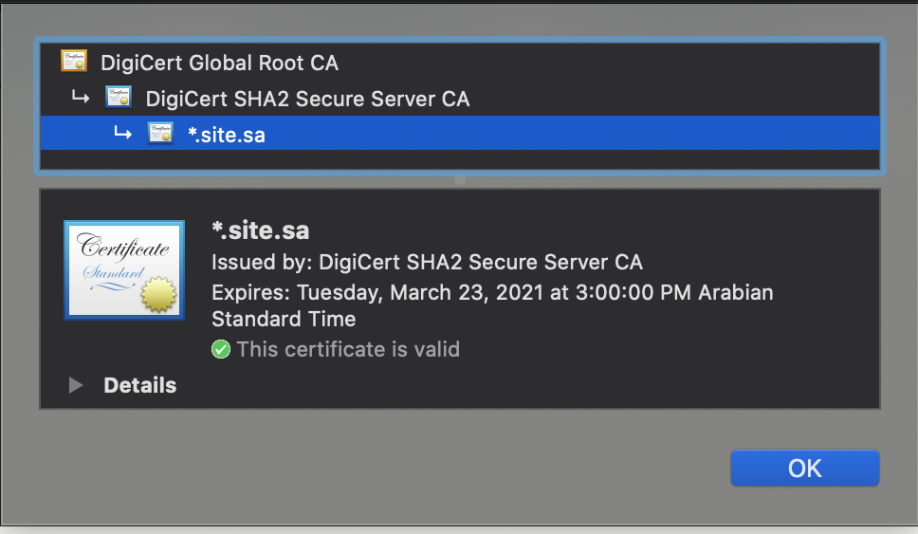
SSL/TLS: Certificate Exchange

Slide 20
SSL/TLS: Session Key Establishment
Session Key Establishment
Here is our new master secret key

Slide 21
SSL/TLS: Change Cipher Spec
Let’s begin secure communication
Note: in this step, they list and use the ciphersuites that they chose earlier

Slide 22
SSL/TLS: Secure Communication
Encrypted Handshake

Slide 23
Attacks on SSLv2
Many issues …
Major vulnerabilities:
Ciphersuite list that is sent from the client to the server was NOT authenticated
Active attacker could modify the message to specify export-weakened ciphers [will talk about it in the next slide] or even Null!
RSA_NULL_NULL
Negotiate Capabilities
I only speak Null Cipher and SSLv2!
Ok … we can do that I guess …
I speak TLS 1.0
I support cipher suites X, Y
Active Adversary

Slide 24
Export Keys
40-bit ciphers
In 2004, a home computer can break it in under 2 weeks
With dedicated hardware, it can be broken in seconds!
Deepcrack (1998)

Slide 25
Browsers No Longer Support Export Ciphers
In 2015, a statistic proved that about 30% of the servers in the wild still use export ciphersuites!
Modern browsers no longer support export ciphers today.
However, we can still use curl and wget ^_^

Slide 26
SSLv2 Deprecation
SSLv2 was deprecated in 2011

Slide 27
SSLv3
All of the problems of SSLv2 has been fixed!
The communication message between the client and server is now authenticated using a MAC (Message Authentication Code) so attackers can’t change it!
However, the “change cipher spec” message is NOT included in the MAC!
This means that the attacker can now read your traffic because he CAN change the ciphers AGAIN!

Slide 28
Version Rollback
The release of SSLv3 didn’t make SSLv2 browsers go away immediately
Servers still accepted SSLv2 requests
Attacker could specify SSLv2 and actually perform SSLv2 Attacks on SSLv3

Slide 29
Traffic Analysis:SSLv3
With the request, an attacker can see the size of the HTTP request.
This may allow him to “guess” things such as:
The file the user downloaded via its size
The visited URL
This is even worse in VoIP! Why?
Silence !
How is this fixed?

Slide 30
SSLv3: Weak Ciphers All the WAY!
SSLv3 and below only supported cipher suites that were affected by POODLE (Padding Oracle Attack)
The only cipher that wasn’t affected was RC4, which leaks information!
As a result, SSLv3 was deprecated in 2015

Slide 31

HTTP > HTTPS
How do you visit Google?
This will be an HTTP request on port 80
Google.com
Redirects the user to https://google.com
https://google.com
This will be an HTTPS request on port 443
What’s the problem here?

Slide 32
HSTS (HTTP Strict Transport Security)
IF it is enabled at that server, and your browser has already contacted the server before using a secure communication, it will NEVER send an HTTP request to that server!
Basically, what it does is that it will PIN this website to ALWAYS use HTTPS
Downside?
Trust on first use

Slide 33

Chrome HSTS
Chrome has a list of websites that it will always connect to via HTTPS

Slide 34
Deterministic Encryption
Enc(plaintext message,key):
m1
m2
m3
m4
m5
m6
c1
c2
c3
c4
c5
c6

Slide 35
Issue of Using Deterministic Encryption
Enc(plaintext message,key):
A
B
A
padding
padding
padding
?
?
?
?
?
?

Slide 36
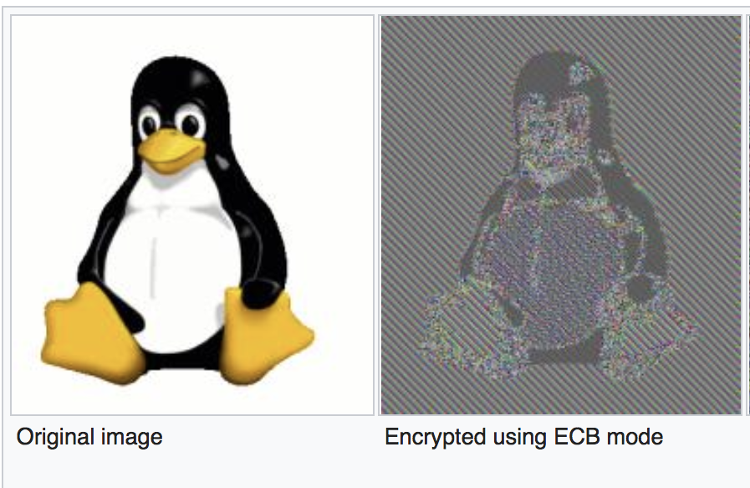
Issue of Using Deterministic Encryption

Slide 37
Semantic Security
An encryption algorithm is secure if an attacker who sees the ciphertext learns as much as an attacker who does NOT see the ciphertext
Even if an attacker can request a chosen plaintext.
Think about cards (alphabits, cards, etc.)

Slide 38
Solution to the Earlier Problem?
Randomization through an Initialization Vector (IV)
Different IV in each block
CBC Mode for example

Slide 39
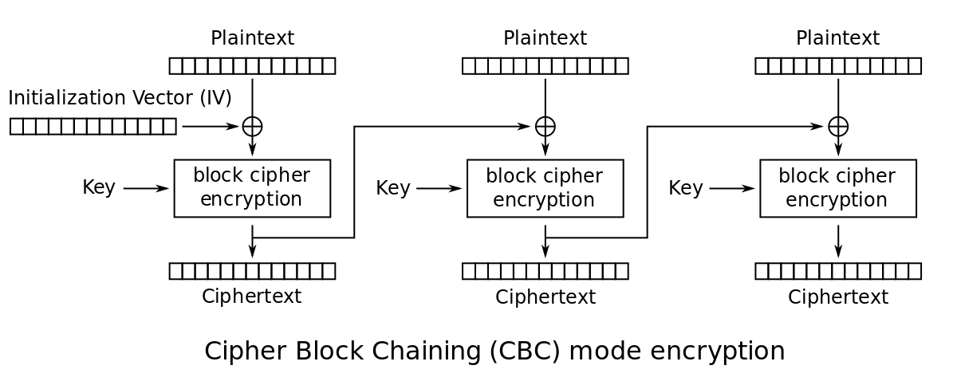
Cipher Block Chaining (CBC) Mode

Slide 40
Padding Oracle Attack (POODLE)
Allows an attacker to decrypt the data without knowing the encryption key
Only works when the application returns different responses to deciphering messages. I.e. valid or invalid padding/mac.
Assuming that an attacker was able to capture the ciphertext & the destination returns a meaningful message when the padding is wrong.
256 unique ASCII characters.
Basically, we need to loop from 0-255 for every byte at the end of the ciphertext until the oracle says the padding is correct. Once it is correct, we move on to the next character and so on. Then byte by byte the plaintext will be revealed.
SSLv3 was vulnerable to POODLE

Slide 41
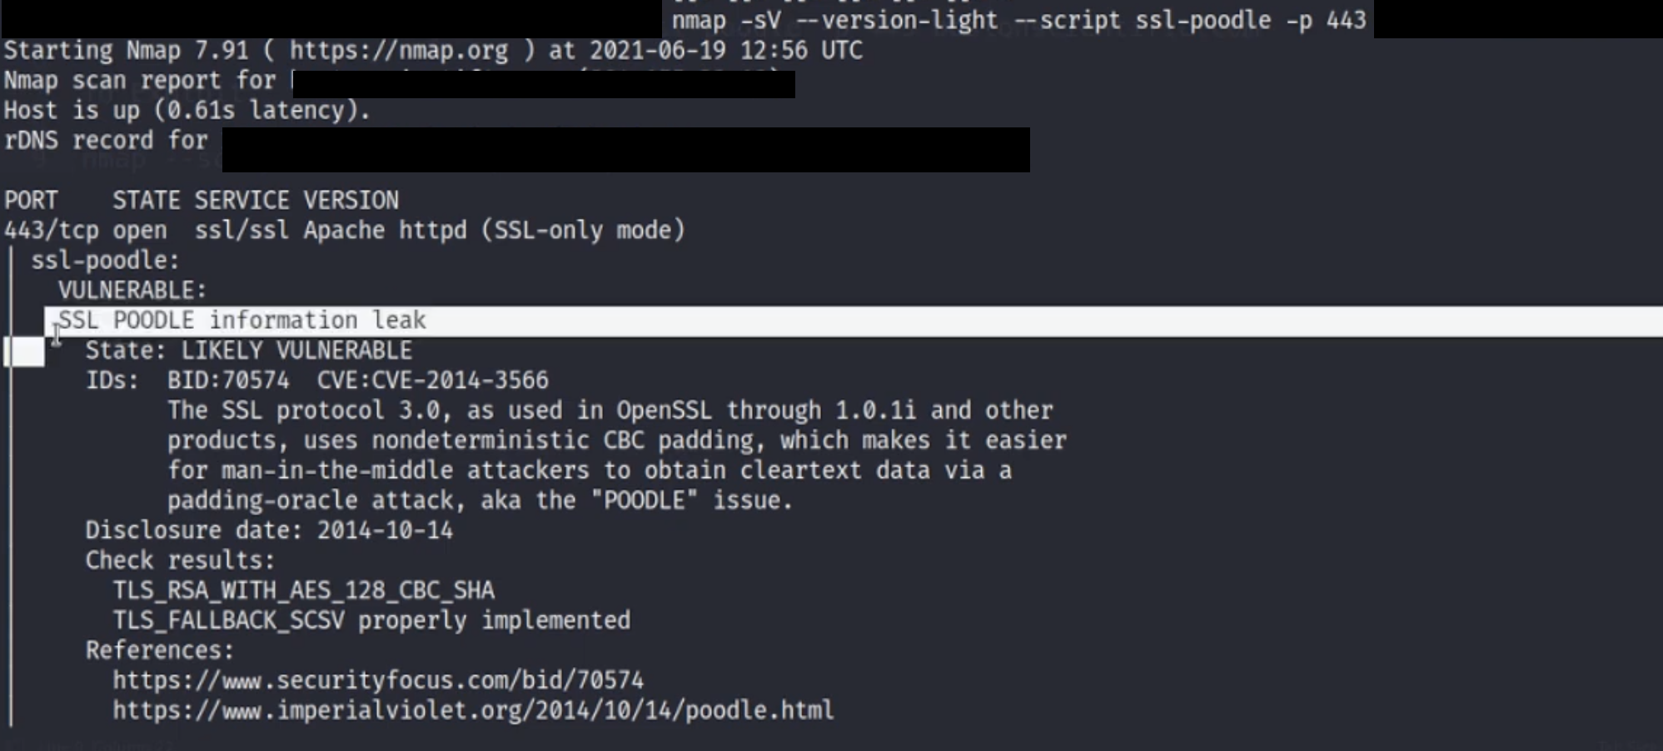
Padding Oracle Attack Testing
Alternatively, you can Use Metasploit’s : auxiliary/scanner/http/ssl_version

Slide 42
SSL’s Solution for the Problem?
Removed the messages instead of solving the main issue
What can go wrong?
TIME!

Slide 43
Best Solution?
Use a different mode of operation
Otherwise, display a generic message with a delay
Even better, implement encrypt THEN MAC. This will result in the ciphertext being dropped if it was tampered with EVEN with CBC mode.

Slide 44
TLS 1.0
Allows for downgrading the connection into SSLv3, which also downgrades to SSLv2 …
Vulnerable to BEAST and DROWN Attack, which will be explained soon

Slide 45
Drown Attack
Mainly touches SSLv2
However, due to the compatibility “feature” some TLS1.0 was vulnerable!
Requires SSLv2 to exist in the server side!
Discovered in 2016
At the time of the discovery, 33% of the webservers were vulnerable.
In 2019, it seems that 1.2% of all webservers are still vulnerable.

Slide 46
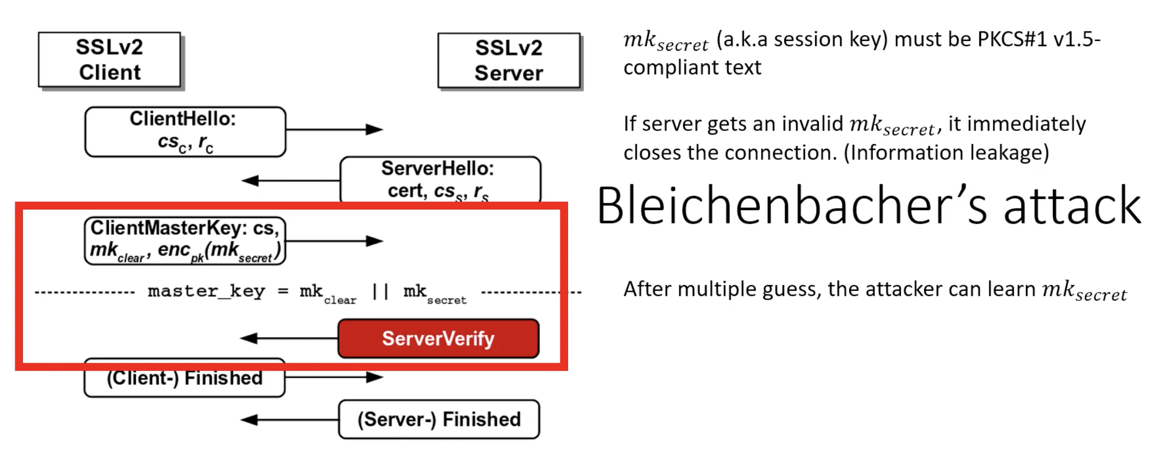
DROWN Attack
Picture credit & demo can be seen here: https://www.youtube.com/watch?v=qkc0ZUvWSYo

Slide 47
BEAST Attack
An Active MITM attacker can predict the IV, therefore, making the result of the encryption deterministic.
Technically, an attacker can’t decrypt any data, however, he can find out if his guessing is right or wrong.
With enough guessing, any data can be recovered!
The only way to prevent BEAST attack from the server side is to enable RC4.
However, RC4 is worse!
This makes enabling TLS 1.0 a bad idea as well

Slide 48
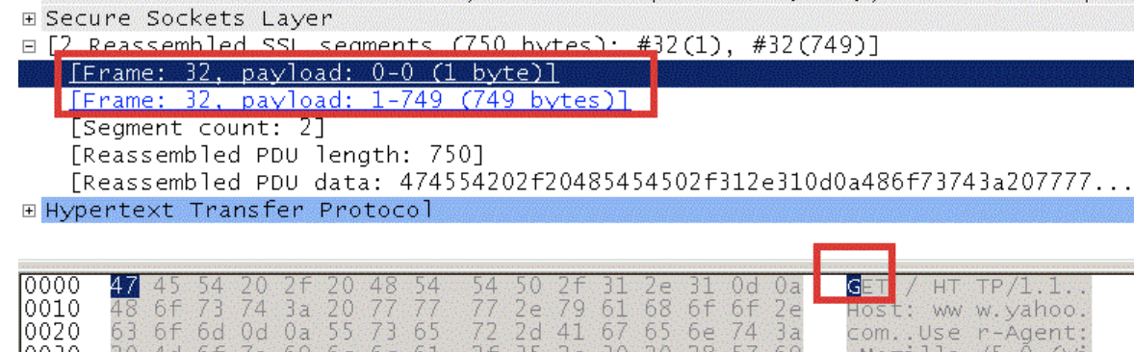
Beast Attack Risk
Guessing is not “really” efficient.
ALL browsers addressed it using a technique called 1/n-1 split.
The first packet will be padded with random data before being combined with the initialization vector.
The risk from Beast Attack is actually LOW.

Slide 49
TLS 1.1
You can actually get away with TLS 1.1 with certain rules. In fact, Google still uses TLS 1.1!
1- you MUST disable all the insecure ciphersuites. This may or may not introduce other problems (i.e. legacy systems)
2- you must NOT have SSL v3.0 or SSLv2.0 enabled in your server.
The main issue here (including in TLS 1.2) is the ciphersuites selected!
Consider having NULL cipher in TLS 1.2, does that make your connection secure?
Note: I’m NOT suggesting that you keep TLS 1.1, they are old already

Slide 50
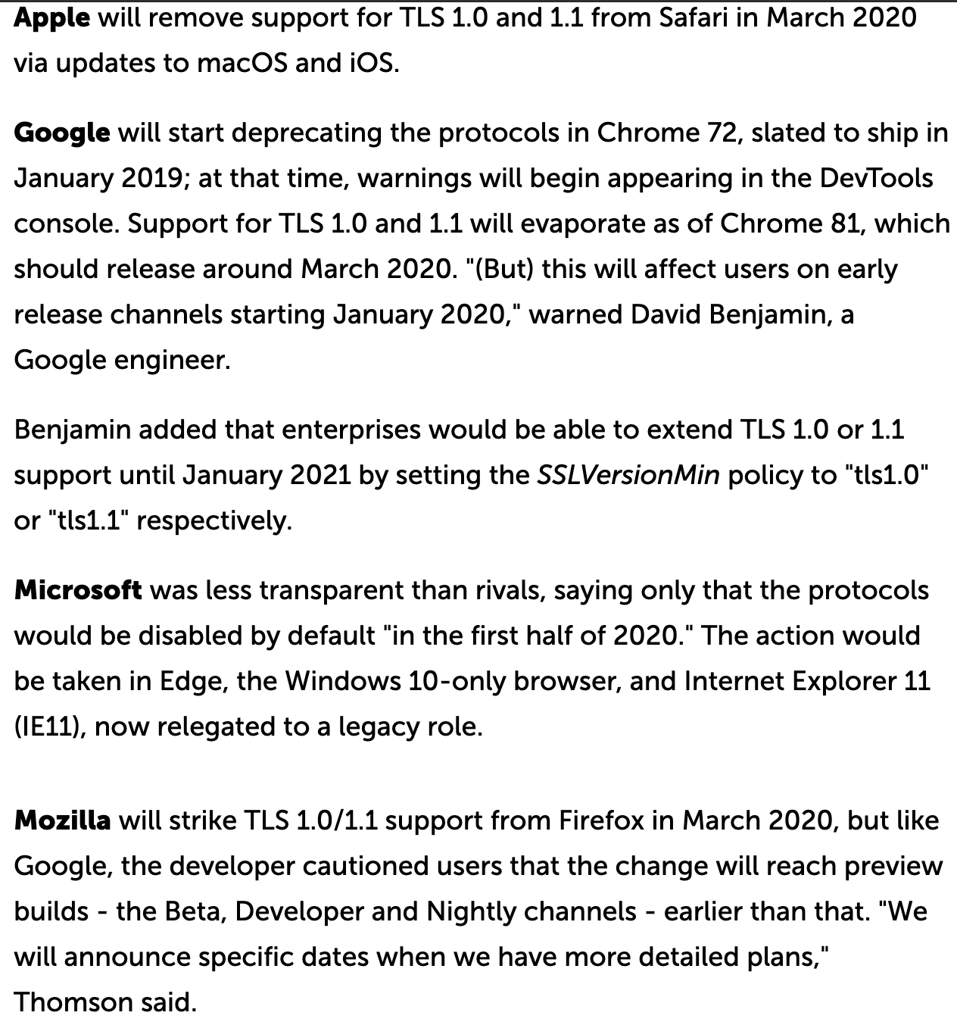
Browsers Ended Support for TLS1.0 & TLS1.1 in 2020

Slide 51
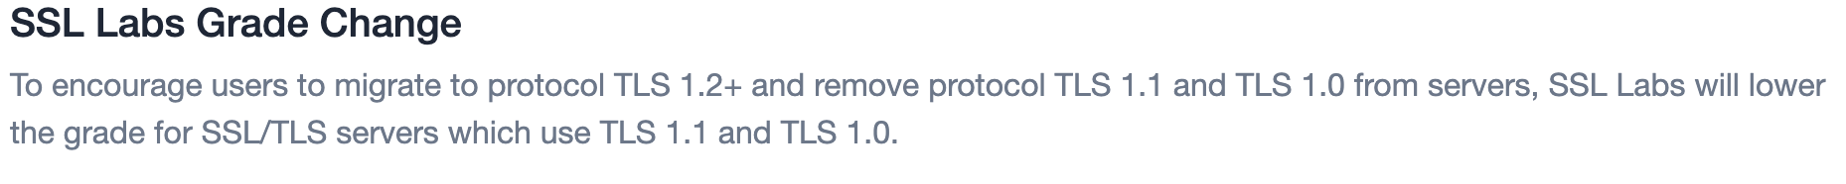
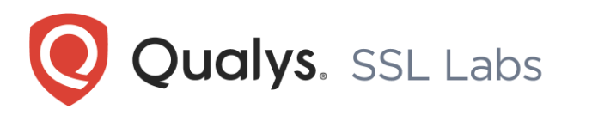
Qualys SSLLabs Also Decreased the Grade!

Slide 52

HeartBleed
OpenSSL is an application that implements TLS/SSL.
The majority of servers uses OpenSSL to enforce SSL/TLS.
HeartBleed was a vulnerability in the OpenSSL cryptography library, not the TLS protocol itself!
The issue was introduced in 2012 and publicly disclosed in 2014.
Main reason: invalid validation of boundaries. This vulnerability is called buffer over read.
In 2019, Shodan showed that there are still more than 90K devices vulnerable to HeartBleed!
I actually saw it in an engagement last year!

Slide 53
HeartBleed
Basically, when you use OpenSSL, you are securing a socket between you and the server.
A server can only accept and keep alive a number of sockets at the same time.
It terminates a socket after a certain threshold if there is no more activities and the client will have to renegotiate over and over again.
Hence, the “Heartbeat Extension” was introduced to avoid having the renegotiation and provide a keep-alive functionality without continues data transfer.
The Heartbeat can contain anything up to 64KB of data.

Slide 54
HeartBeat in Action (Normal Usage)
Sends 1KB, and says it is 1KB
Returns the same 1KB

Slide 55
HeartBeat in Action (Malicious Usage)
Sends 1KB, and says it is 64KB

Slide 56
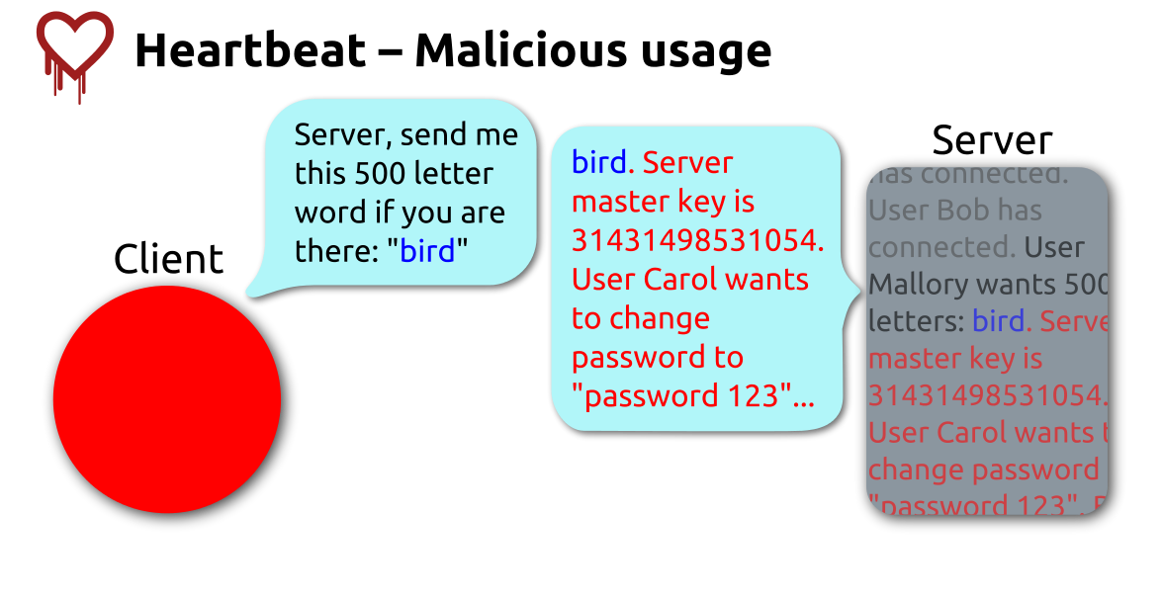
HeartBeat in Action (Malicious Usage)

Slide 57
HeartBleed Exploitation

Slide 58
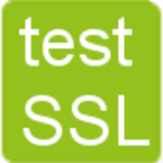


How to Check for SSL/TLS Weaknesses?
A couple of ways to check the SSL/TLS versions & the ciphersuites a server is using.
The best tools/websites from my opinion are the following:
Nmap NSE scripts
Testssl
Qualys SSL Labs (possible privacy concerns?)

Slide 59
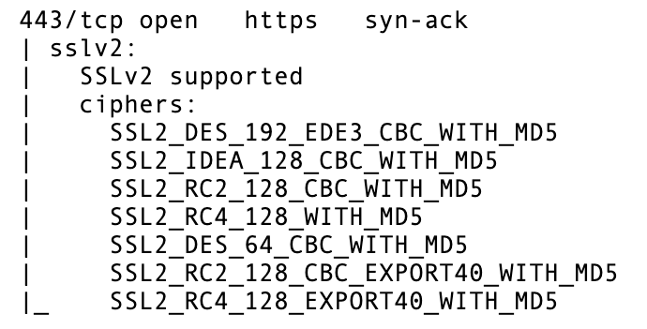
Nmap SSL Checker
We will be using 2 NSEs because one is simply not enough when it comes to Nmap
For SSLv2, we will be using the following:
nmap -p 443 --script sslv2 TARGET
Sample output:
Note: this will ONLY work on servers that support SSLv2 & it will NOT check for other versions!

Slide 60
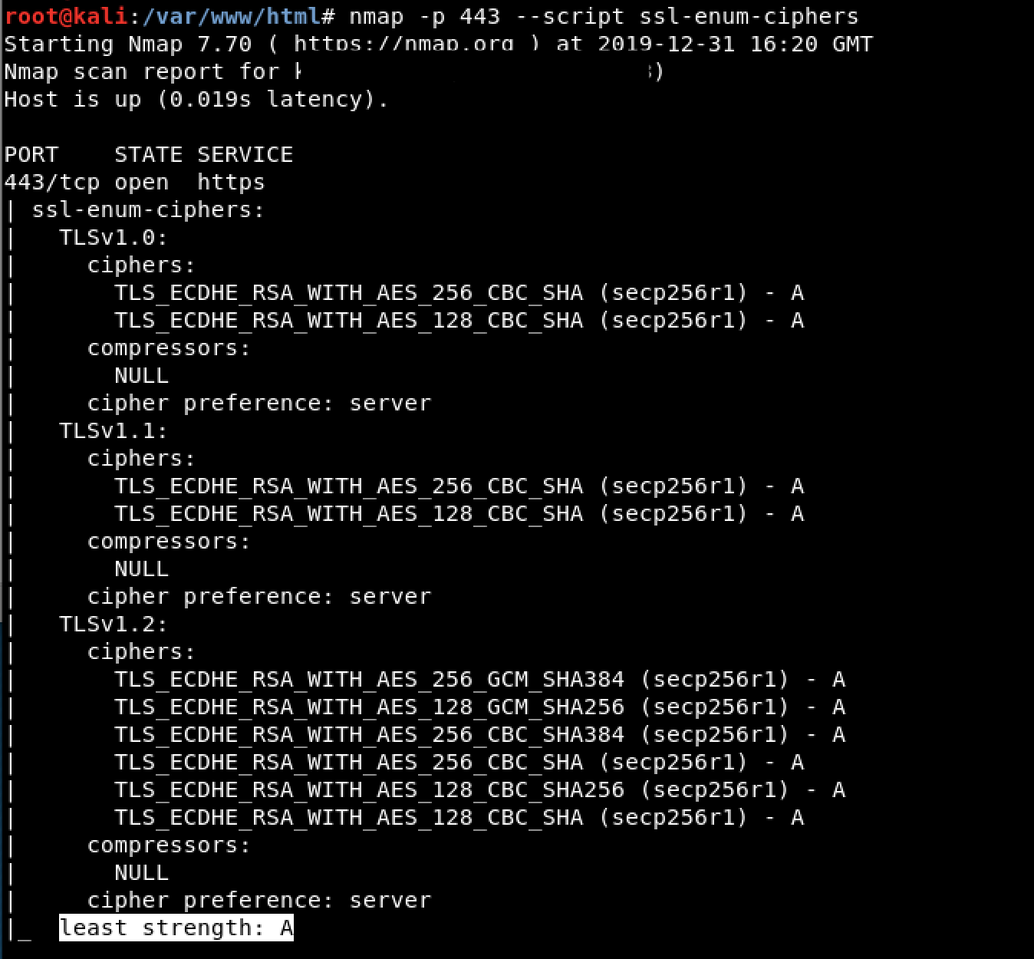
Nmap SSL/TLS Checker
When it comes to SSLv3 and above, we will be using a different NSE.
nmap -p 443 --script ssl-enum-ciphers TARGET
An example of a websites that has the best practice can be seen here:

Slide 61
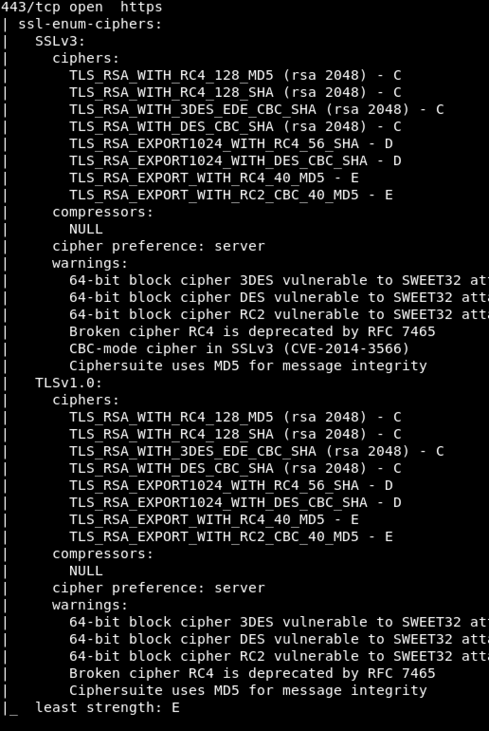
Nmap SSL/TLS Checker
What are the issues here?

Slide 62
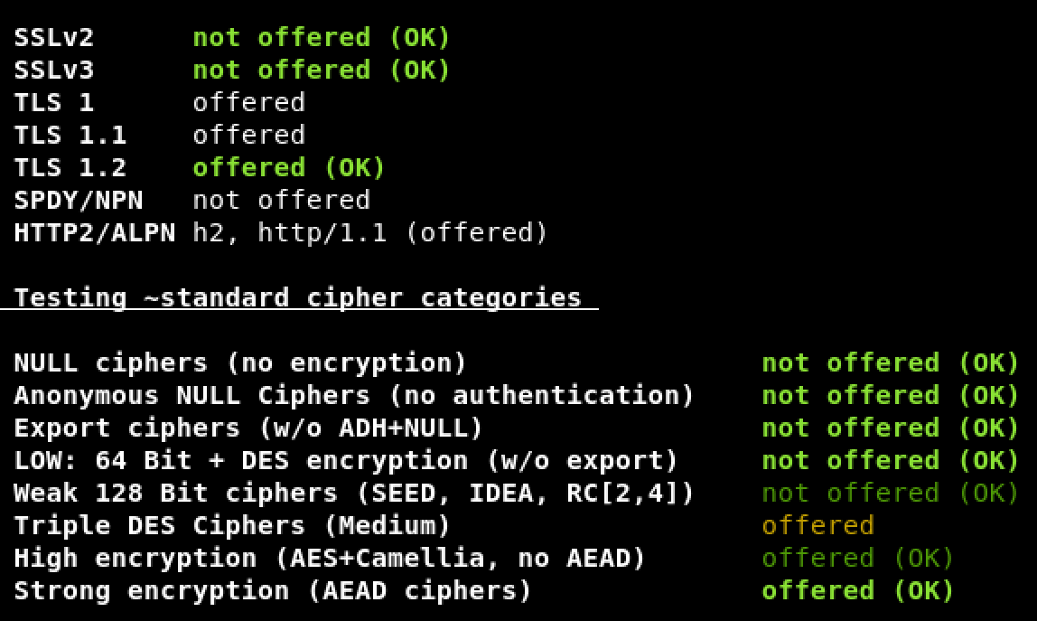
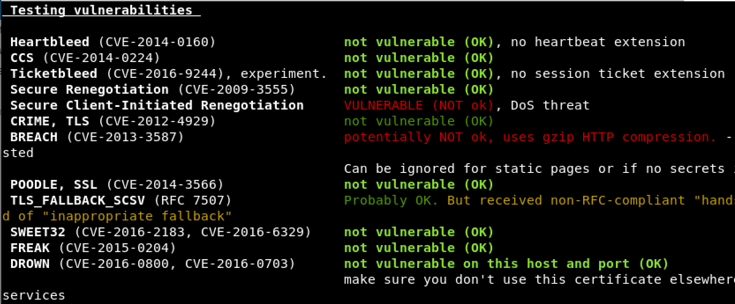
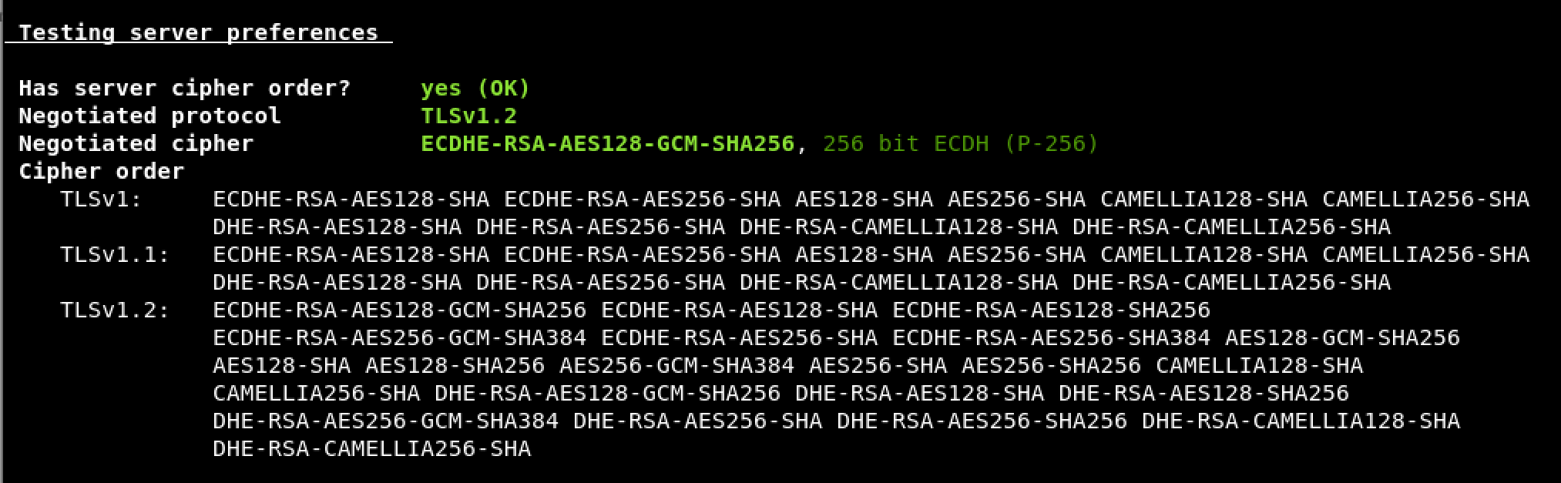
TestSSL
Open-sourced Bash script
VERY powerful
You don’t need to switch between 2 scripts like Nmap
Tests for supported protocols & supported ciphersuites that may cause an issue
It checks the server preference, HTTP headers, and even SSL/TLS vulnerabilities!

Slide 63
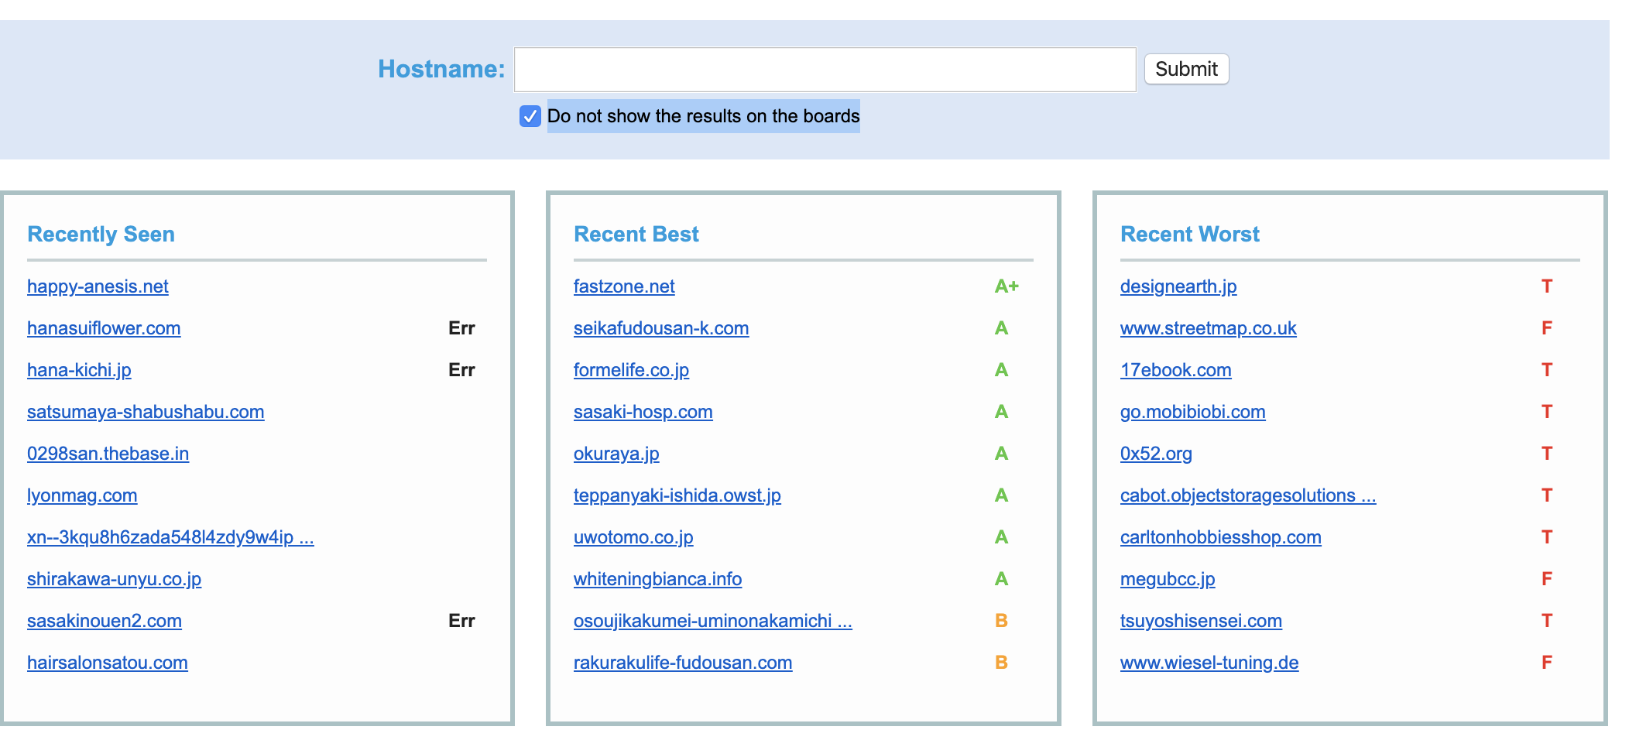
Qualys SSL Labs
A free website created by Qualys to test the SSL/TLS strength of websites
It gives each website a rating from A+ to F based on the strength of the supported protocols & ciphersuites
It also gives detailed information about what is weak exactly in the TLS/SSL your server/website is using.
Keep in mind that this means that you are using a CLOUD based website.
If you are not careful, even other people can see your search query!

Slide 64
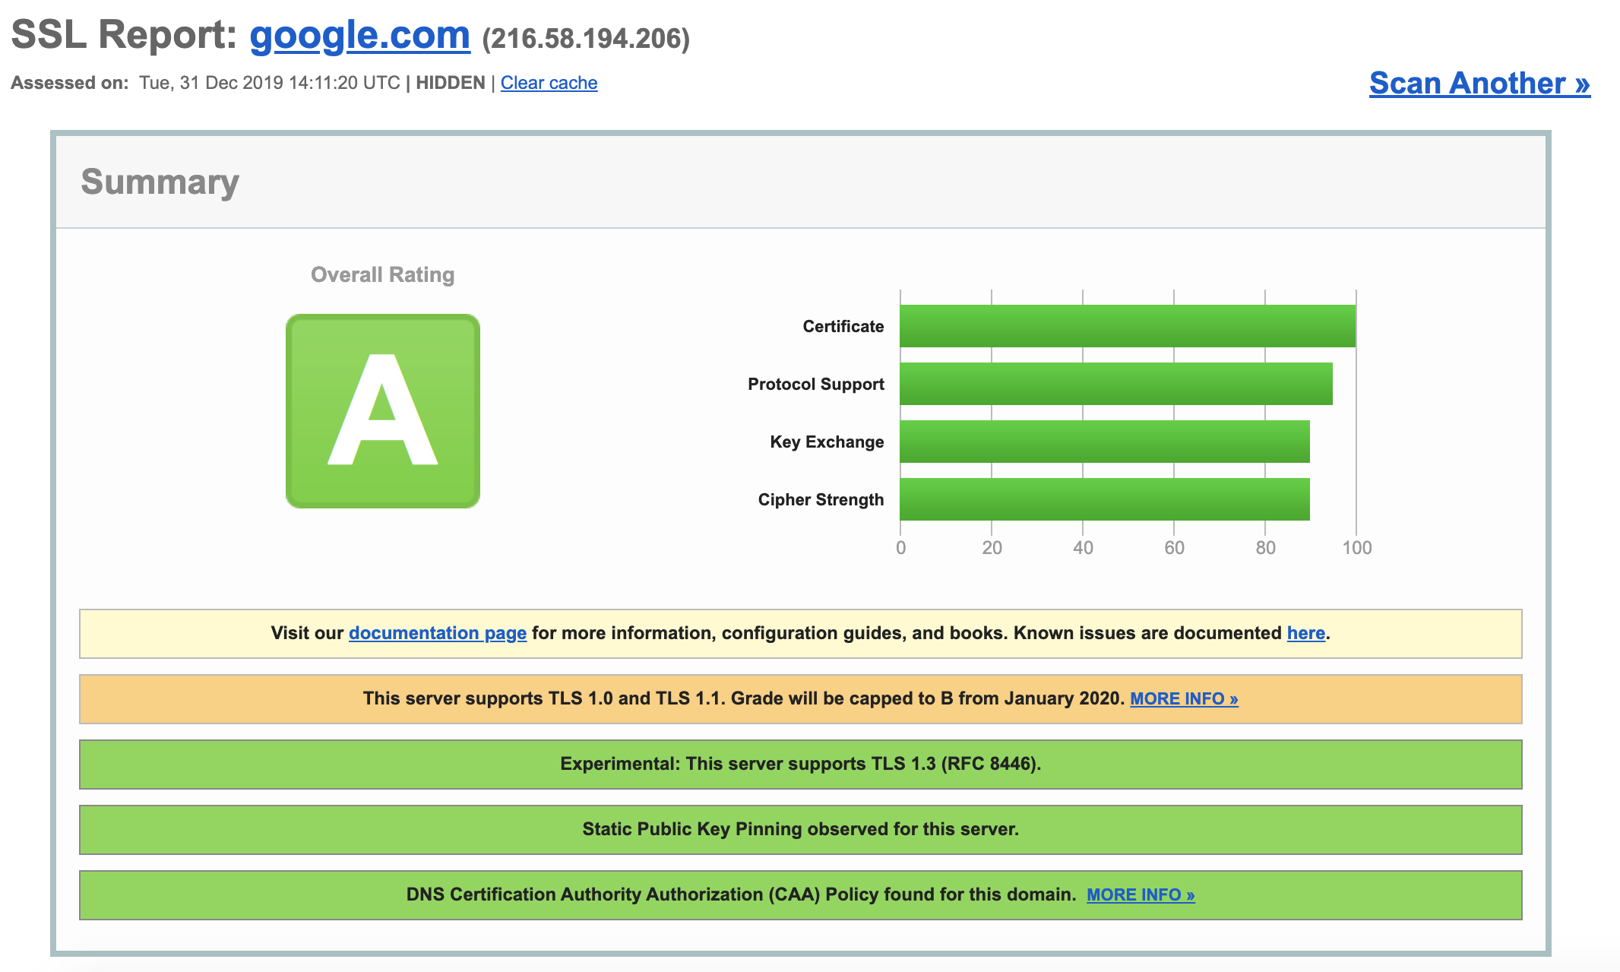
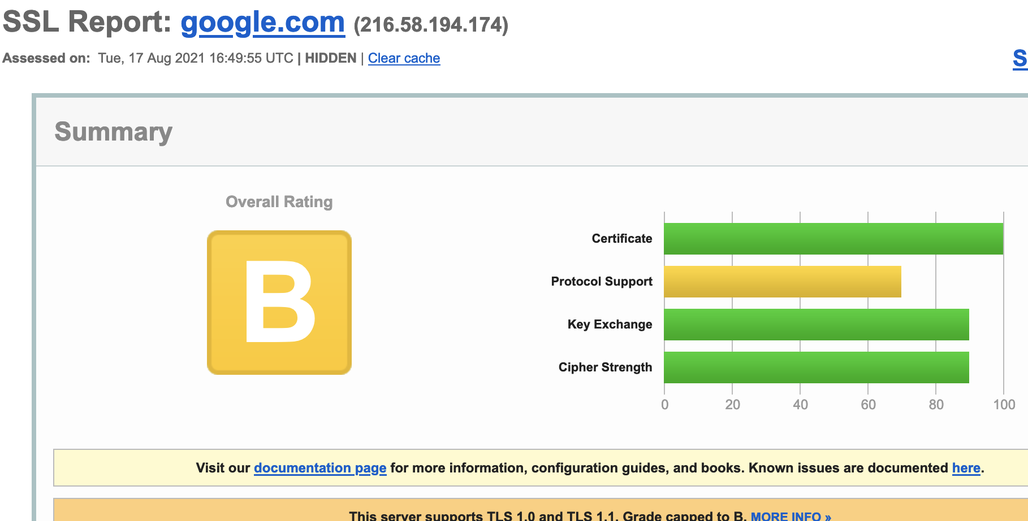
Qualys SSL Labs
The screenshot above was taken on December 31st, 2019, showing Google.com with grade A even with the support of TLS 1.0 & TLS 1.1
The one below was taken on August 17th, 2021, showing Google with a grade of B due to its support of TLS 1.0 & 1.1
You can see all the details about the certificate (start & end date, issuers, supported protocols & ciphers for each, etc.)

Slide 65
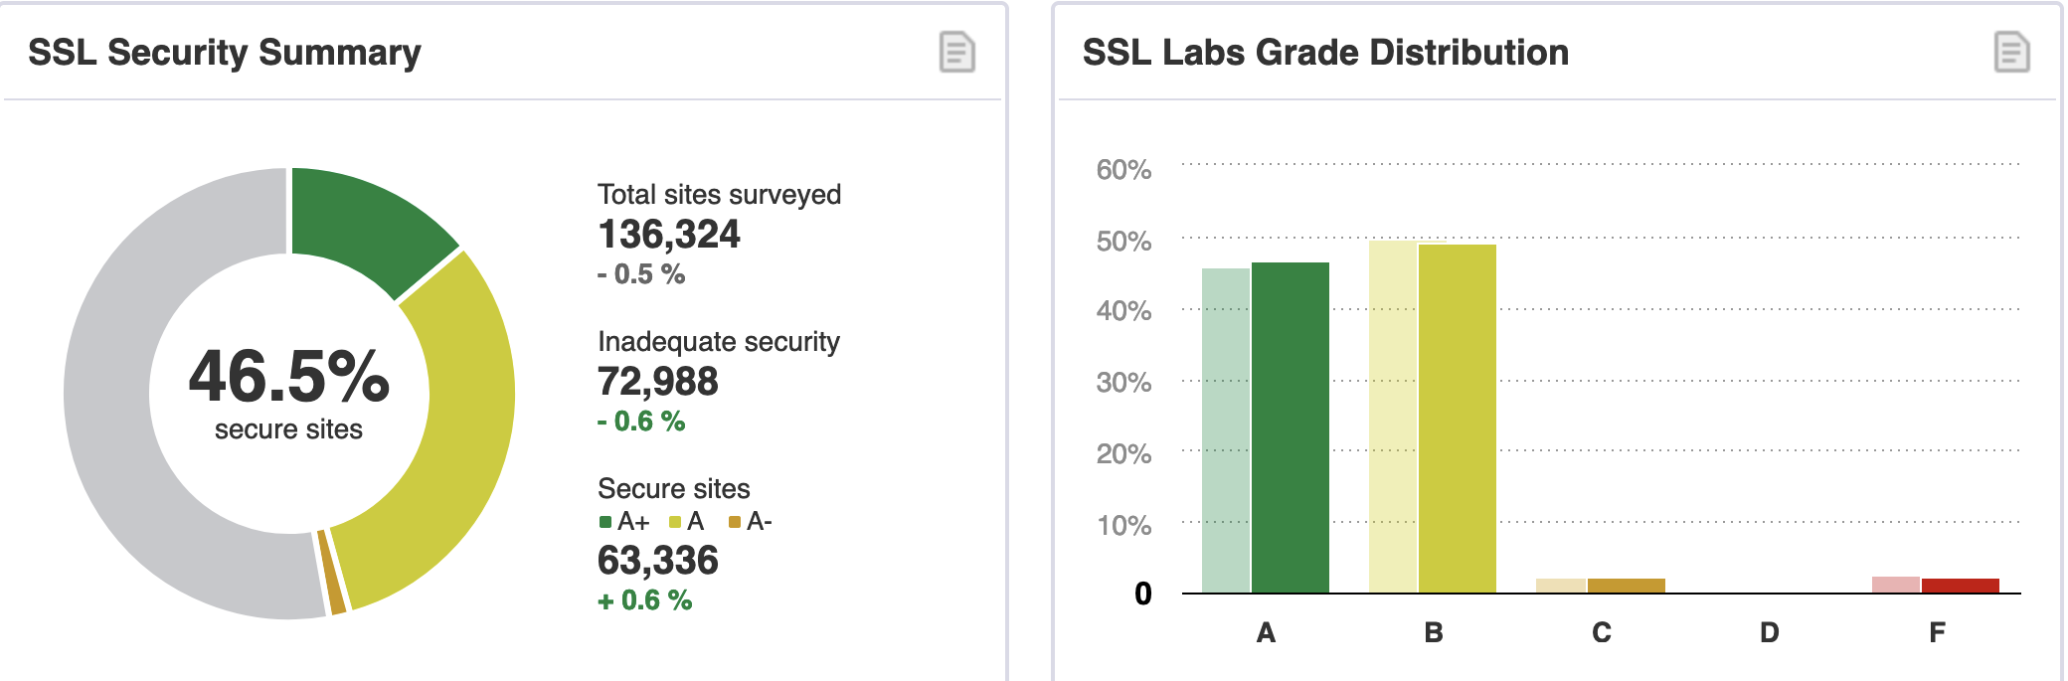
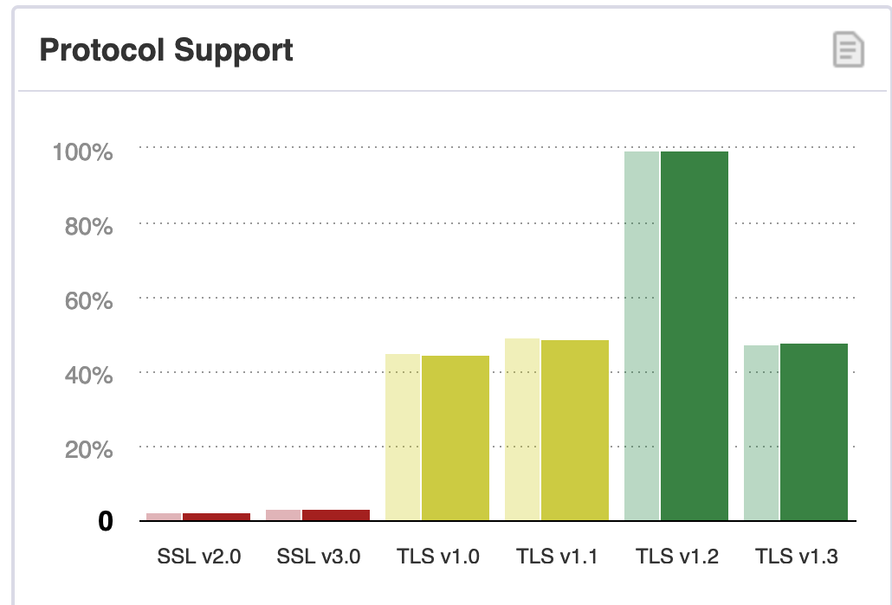
Qualys SSL Labs

Slide 66

Any Questions?

